Slide 1
Action Research
Dirk Riehle, Univ. Erlangen
NYT C04
Licensed under CC BY 4.0 International

Slide 2
Agenda
Action research
Participatory action research
Problem identification
Research design
The action-feedback loop
Quality assurance

Slide 3
1. Action Research

Slide 4
Action Research
Action research is a research methodology in which the researcher
Iterates over applying, evaluating, and revising a theory
To cause change and build out the theory
Key is
The active involvement (the “action” and/or “intervention”) and
Its expected effects in the world
The researcher is not just a distant observer!

Slide 5
Facilitation vs. Participation
The researcher is not necessarily executing the action themselves
An outside researcher is a facilitator
An inside researcher is a participant

Slide 6
Duality of Purpose
The goal of action research is to
Improve practice
Build out a theory

Slide 7
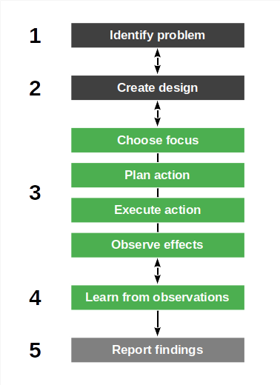
The Action Research Process
Action research is linear yet iterative
Identify (research) problem
Create research design
Perform action
Choose focus
Plan action
Execute action
Observe effects
Learn from observations
Report from findings

Slide 8
Three Motivations for Action Research
Technical action research is interested in
Improving control over outcomes
Educational action research is motivated by
Helping practitioners act more wisely
Critical action research is motivated by
Emancipating practitioners

Slide 9
Variants of Action Research
Action research (AR) is
The original research methodology (as before)
Participatory action research (PAR) is action research in which
The researcher is an active participant of the whole research process
Critical (theory) participatory action research is action research in which
The research uses critical theory as the underlying epistemological position
Critical theory seeks
“to liberate human beings from the circumstances that enslave them” [1]
[1] See Horckheimer (1982): Critical theory.

Slide 10
As a Research Methodology Category
Action research (Lewin, 1946)
Participatory action research (McIntyre, 2008)
Critical participatory action research (Kemmis et al., 2014)

Slide 11
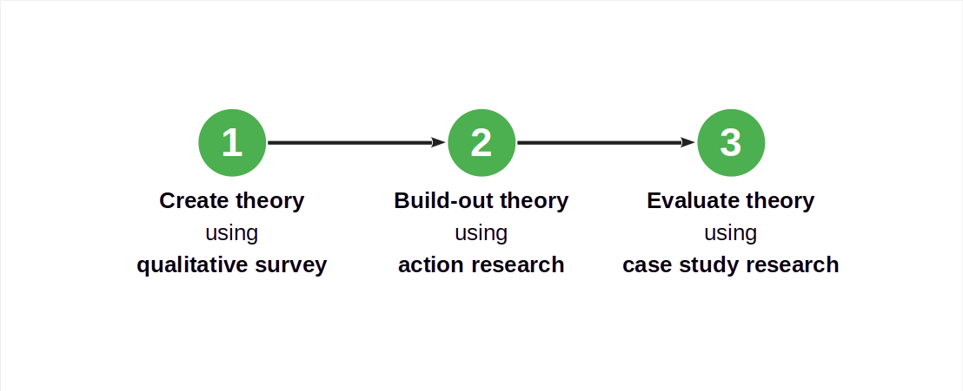
Action Research in a Larger Research Design

Slide 12
A Sweet Spot for Action Research
Participatory action research is a good choice if
There is an initial theory already in place
The researcher has access to appropriate cases
The theory under development is evolving quickly
There is significant tacit knowledge with the researcher
Participants expect to learn/benefit from the research

Slide 13
Industry Consulting as Action Research
In industry consulting (paid or unpaid), a researcher provides advice to practitioners
Researchers are called upon to help improve the outcome of practitioner work
They do not have to be participants (of implementation), but may simply advise
Industry consulting on new, novel topics, works well with action research

Slide 14
2. Participatory Action Research

Slide 15
Participatory Action Research (PAR)
Participatory action research is action research in which
Researchers and practitioners perform the research jointly and collaboratively
For the practitioners, this has the following consequences; they
Can understand and develop practices while on the case
Can develop a joint, reflective, language of critical debate
Can form communities of practice based on the research
Participatory action research is a “practice-changing practice” [1]
[1] See Kemmis et al. (2014): Critical participatory action research.

Slide 16
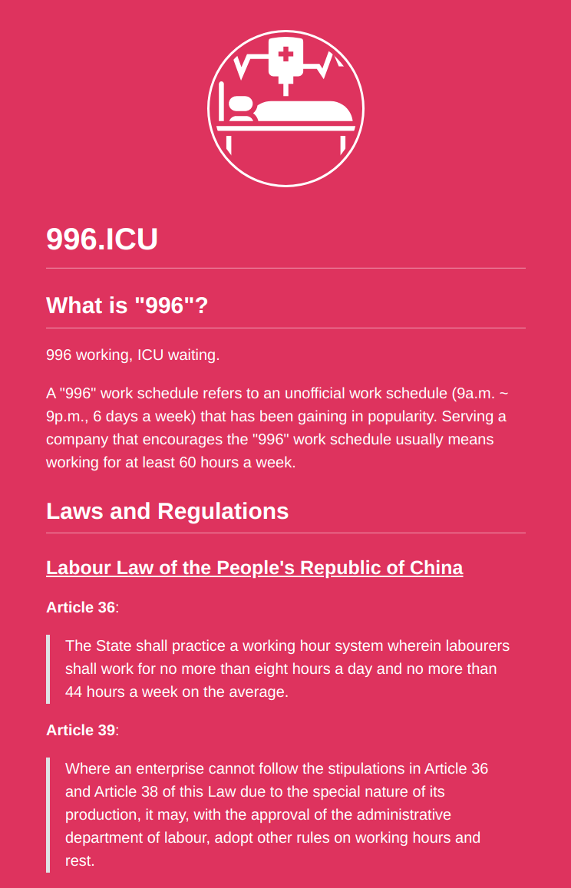
Critical Participatory Action Research (CPAR)
Critical participatory action research is action research that
Empowers participants to change practices in the face of
irrational
unsustainable
unjust situations
With this addition of critical theory, we are leaving positivism
No objective independent reality but rather
Individual and collective action and reflection

Slide 17
Context Specificity / No Fixed Formula
Participatory action research is context-dependent research
Every research project is different and so are the employed methods
May require significant adaptation to situation beyond the core process
Participatory action research has no single theoretical framework

Slide 18
Roles in Participatory Action Research
Everyone is a participant, some are
Researchers
Practitioners
You are either in the researcher or practitioner role
Researchers are temporary participants
Practitioners are (more) permanent participants

Slide 19
Participation vs. Involvement
Participation
Participants are stakeholders
Participation may be uneven
Involvement
No agency or ownership

Slide 20
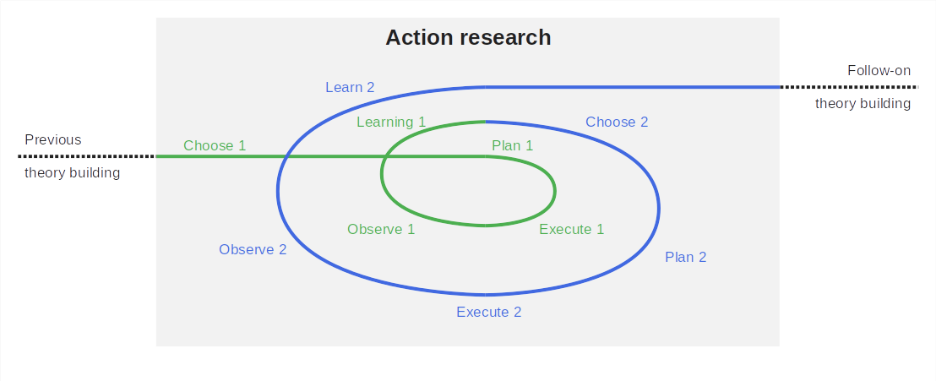
The Action Research Process in Context

Slide 21
Activity Names by Methodology Variant
Generic | Action research [1] | Participatory AR [2] | Critical PAR [3]
– | – | Questioning | –
Choosing | – | Investigating | Reconnaissance
Planning | Planning | Developing | Planning
Executing | Executing | Implementing | Enacting
Observing |  |  | Observing
Learning | Fact-finding | Refining | Reflection
[1] See Lewin (1946): Action research.
[2] See McIntyre (2008): Participatory action research.
[3] See Kemmis et al. (2014): Critical participatory action research.

Slide 22
3. Problem Identification

Slide 23
Problem Identification
You choose action research, because
Your theory is young
You may have a project at hand
The project can benefit from your help
You approach the project with the goal of
Helping practitioners
Performing research

Slide 24
Example Problem Identification
We identified a need by companies to manage using open-source software
[1] See Riehle et al. (2021): Pattern discovery and validation.

Slide 25
4. Research Design

Slide 26
The Handbook Method
The handbook method is an approach for taking research results into practice
A research theory is codified as a best practice handbook of the domain
The best practices are derived from practitioners using a qualitative survey
Using action research, a researcher helps a practitioner apply the handbook

Slide 27
Example Theory Building
We identified a need by companies to manage using open-source software
First, we developed a theory using a qualitative survey
We then codified (wrote down) the theory as a best practices handbook
The resulting theory had substance but was still young
We then took the handbook to an industry partner for participatory action research

Slide 28
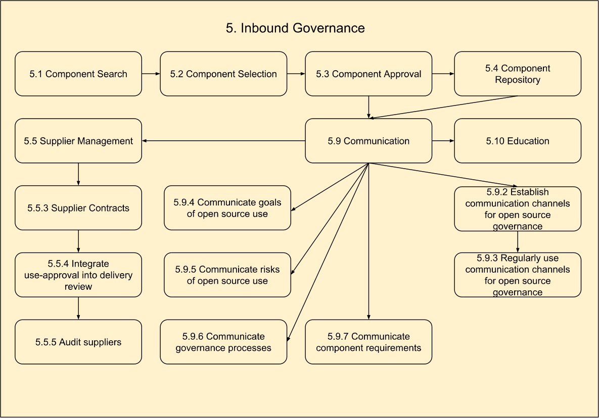
Illustration of Open Source Governance Handbook 1 / 3
Base structure
Domains
Workflows
Practices

Slide 29
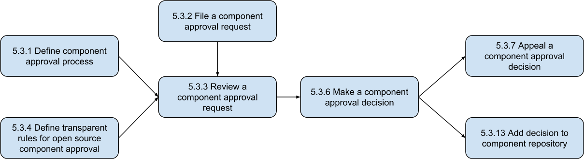
Illustration of Open Source Governance Handbook 2 / 3

Slide 30
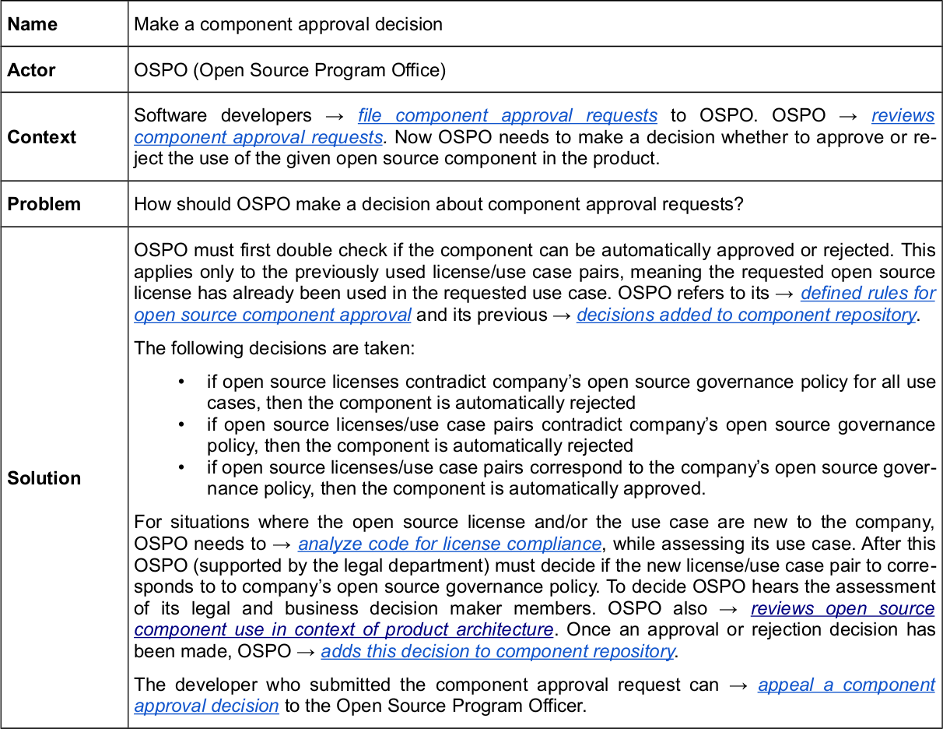
Illustration of Open Source Governance Handbook 3 / 3

Slide 31
Research Protocol
As before, describe methods and data to be acquired
As you are now dealing with human subjects, also
Review research ethics and implications
Document expected effects on human subjects
Devise strategies for protecting human subjects
Acquire and document ethics board approval
Include this additional information in research protocol

Slide 32
5. The Action-Feedback Loop

Slide 33
Choose Focus
During choosing (focus), you
Choose which aspect of your theory to build out
Criteria to choose focus by can be
Strategic: Immaturity of theory aspect chosen
Pragmatic: Aspect readily available in project
Action research prefers pragmatic choices
Because it is about helping practitioners

Slide 34
Example of Choosing Focus 1 / 2
We decided early to focus on the component approval process
Component approval is a critical process in open source governance

Slide 35
Example of Choosing Focus 2 / 2
As participant improving practice
We helped review the situation
As researcher performing research
We performed participant observation

Slide 36
Plan Action
During planning, you
Choose an appropriate method to perform the action and investigate its effects

Slide 37
Example of Planning an Action 1 / 2
We worked with the OSPO to define the component approval process
We used the handbook to define a first version of the process

Slide 38
Example of Planning an Action 2 / 2
As participant improving practice
We helped define the process
As researcher performing research
We continued participant observation

Slide 39
Execute Action
During execution, you follow your plan and
Participate in the project working on the aspect of choice

Slide 40
Example of Executing Action 1 / 2
We helped the first component approval processes along
We performed both entry and exit interviews
We performed participant observation

Slide 41
Example of Executing Action 2 / 2
As participant improving practice
We helped the first process instances
As researcher performing research
We continued participant observation
We performed entry interviews
We performed exit interviews

Slide 42
Observe Effects
During observation, you continue with your plan and
Observe the results of the execution using the methods you chose

Slide 43
Example of Observing Effects 1 / 2
After the action, in addition to in-action observations, we reviewed the results
More interviews with the OSPO after a couple of instances had run
Taking note of statistics (duration, complications, results)

Slide 44
Example of Observing Effects 2 / 2
As participant improving practice
None
As researcher performing research
Continued participant observation
Conducted additional interviews
Took notes of emerging statistics

Slide 45
Learn from Observations
During learning, you
Analyse the observed data towards the aspect of interest

Slide 46
Example of Learning from Observations 1 / 2
We built out our theory and used it to provide feedback and make suggestions

Slide 47
Example of Learning from Observations 2 / 2
As participant improving practice
Discussed ways to improve process
As researcher performing research
Integrated collected data into theory

Slide 48
Closing the Action-Feedback Loop
Based on what you learned, you
Either continue with another iteration of action research
Or move on to next steps (publications / methodology)

Slide 49
6. Quality Assurance

Slide 50
Quality Assurance
Quality assurance is closely tied to the research methods employed
In our example (open source governance) these were
Participant observation
Practitioner interviews
Qualitative data analysis

Slide 51
Summary
Action research
Participatory action research
Problem identification
Research design
The action-feedback loop
Quality assurance

Slide 52
Thank you! Any questions?
dirk.riehle@fau.de – https://oss.cs.fau.de
dirk@riehle.org – https://dirkriehle.com – @dirkriehle

Slide 53
Legal Notices
License
Licensed under the CC BY 4.0 International license
Copyright
© 2012, 2023, 2024 Dirk Riehle, some rights reserved

